Slide 1

Lung Cancer…some basics
Gregory Riely
@RielyMD
March 24, 2025

Slide 2
Disclosures
MSKCC receives research funding for my work from:
Mirati
Lilly
Takeda
Merck
Roche
Pfizer
Rain Therapeutics
Novartis

Slide 3
Things I am not going to focus on, but are important
Smoking cessation is critical
The USPSTF recommends annual screening for lung cancer with low-dose computed tomography (LDCT) in adults aged 50 to 80 years who have a 20 pack-year smoking (Grade B recommendation)

Slide 4
What do I hope you learn today?
Some basics about non-small cell lung cancer
General sense of how lung cancer is staged and how that stage guides treatment
How we measure benefit in clinical trials
Understand that tumor biomarkers are important and molecular testing is necessary for patients

Slide 5
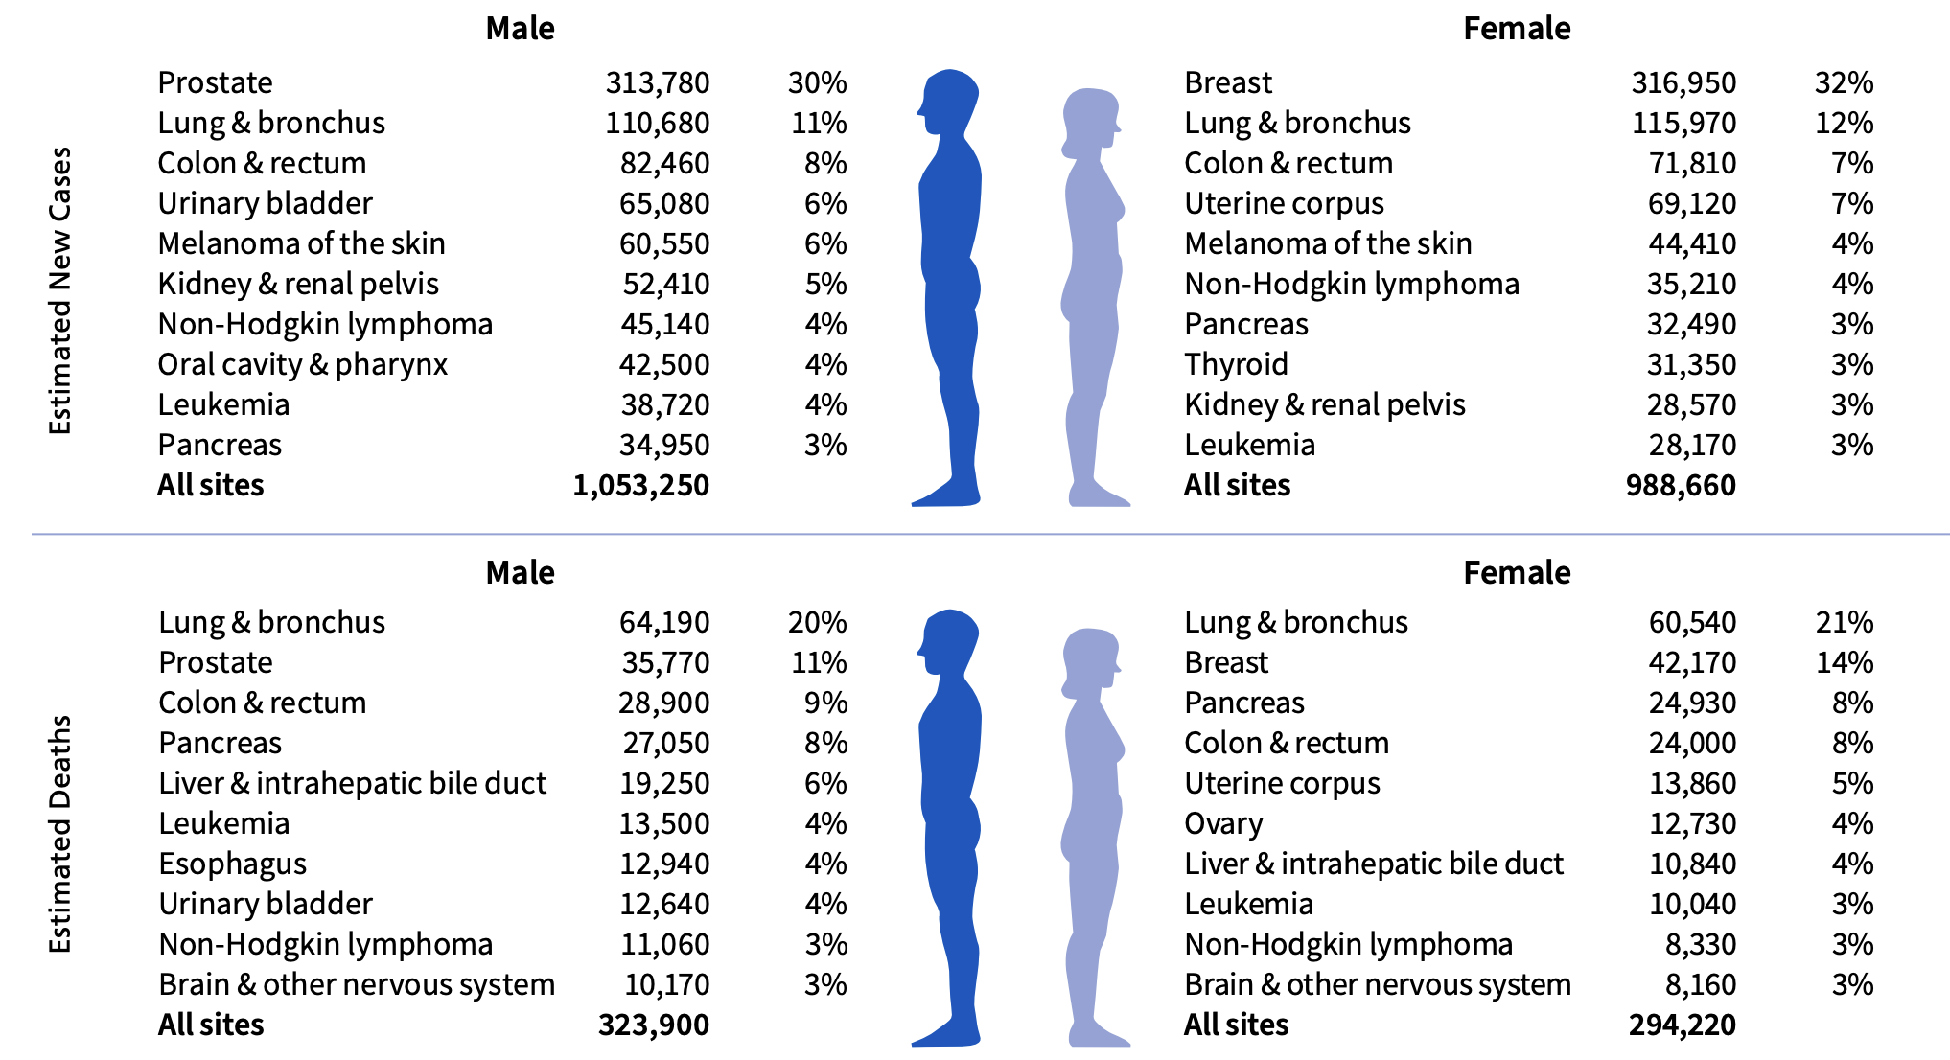
2025 Cancer Incidence and Deaths
Key messages:
Lung cancer deaths are common
(>breast+prostate+colorectal)
Lung cancer cure is usually not cured
Cancer Facts & Figures 2025, American Cancer Society

Slide 6

> 85% of Lung Cancer Is Caused by
Cigarette Smoking

Slide 7
Lung Cancer Deaths
= 124,730 (more than breast + prostate + colon cancer)
Lung Cancer Deaths in Never Smokers
~ 20,000
> Ovarian Cancer
> Kidney Cancer
> Bladder Cancer
~ All Lymphoma
~ All Leukemias

Slide 8
What are the key things you need to know about a patient’s lung cancer to develop a treatment plan?

Slide 9
What are the key things you need to know about a patient’s lung cancer to develop a treatment plan?
Stage (Sites of disease)
Tumor histology
Biomarkers (Somatic genomic alterations/PD-L1 status)

Slide 10
General Overview of NSCLC Staging
Small lung mass
Stage I
>4cm lung mass or hilar nodal involvement
Stage II
>7 cm or mediastinal nodal involvement
Stage III
Curative therapy
Non-Curative therapy
Involvement of
other organs
or contralateral lung
Stage IV
(or Recurrent Disease)

Slide 11
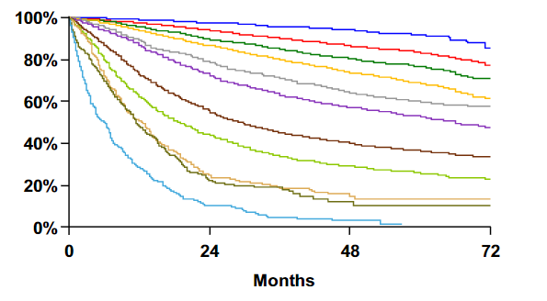
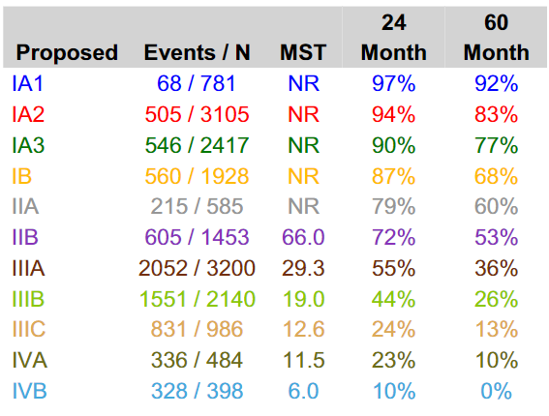
Outcomes by pathologic stage for NSCLC (v8)
Surgically resected patients, 1999 – 2010
Overall Survival
1
3
7
9
Goldstraw, et al. J Thorac Oncol. 2015
Notes:
11
11

Slide 12
General Overview of Treatment by Stage
Stage I
Surgery/radiation
Stage II
Surgery/radiation
Sometimes: chemotherapy, immunotherapy,
targeted therapy
Stage III
Curative therapy
Non-Curative therapy
Chemotherapy, immunotherapy,
targeted therapy
Stage IV
(or Recurrent Disease)

Slide 13
What are the subtypes of lung cancer?
Lung Cancer

Slide 14
Lung Cancer
Small Cell (15%)
Non-Small Cell (85%)

Slide 15
Lung Cancer
Small Cell (15%)
Non-Small Cell (85%)

Slide 16
Lung Cancer
Small Cell (15%)
Non-Small Cell (85%)
Adenocarcinoma (70%)
Squamous cell (15%)
NSCLC-NOS
(15%)

Slide 17
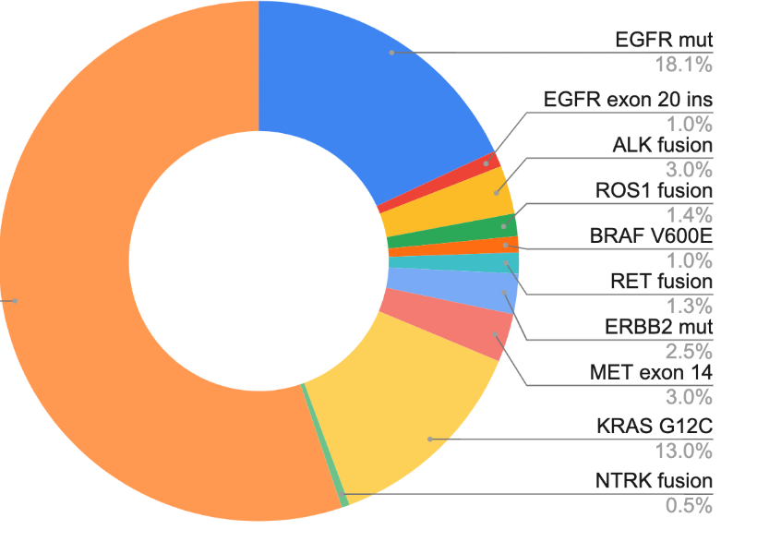
Lung Cancer
Small Cell (15%)
Non-Small Cell (85%)
Adenocarcinoma (70%)
Squamous cell (15%)
NSCLC-NOS
(15%)

Slide 18
NSCLC in 2025
AACR GENIE BPC lung, Data available at https://genie.cbioportal.org/

Slide 19
A brief history lesson…

Slide 20
Endpoints used in cancer clinical trials

Slide 21
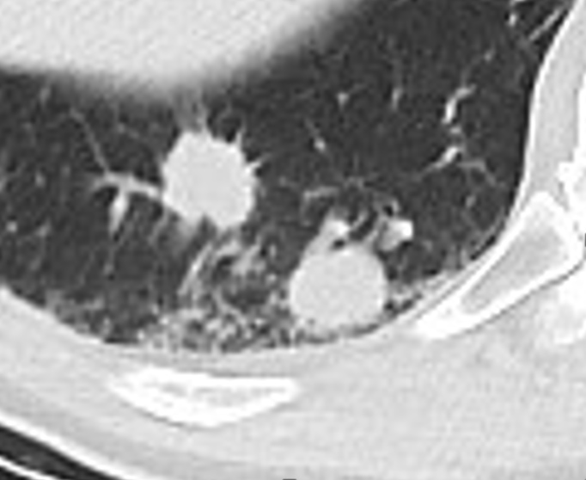
Endpoints used in cancer clinical trials
D
D
Response rate – RECIST - ≥ 30% reduction in diameter of indicator tumors (up to 5, max two per organ)
Progression-free survival – time from randomization until tumor grows 20%
Overall survival – time from randomization until death

Slide 22
Endpoints used in cancer clinical trials
Response rate
Overall survival – time from randomization until death
Complete Response
Partial Response
Stable Disease
Progression of Disease
D

Slide 23
Endpoints used in cancer clinical trials
Response rate – RECIST - ≥ 30% reduction in diameter of indicator tumors (up to 5, max two per organ)
Progression-free survival – time from randomization until tumor grows 20%
Overall survival – time from randomization until death
D

Slide 24
Endpoints used in cancer clinical trials
Response rate – RECIST - ≥ 30% reduction in diameter of indicator tumors (up to 5, max two per organ)
Progression-free survival – time from randomization until tumor grows 20%
Overall survival – time from randomization until death

Slide 25
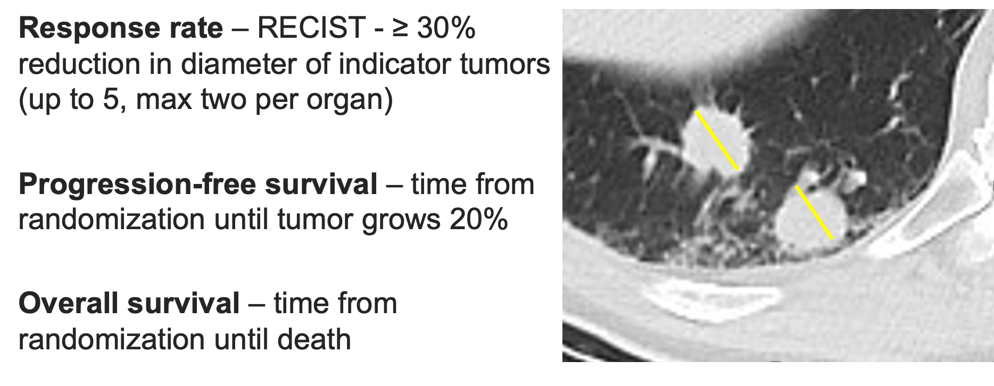
Endpoints used in cancer clinical trials
Surrogate
endpoints

Slide 26
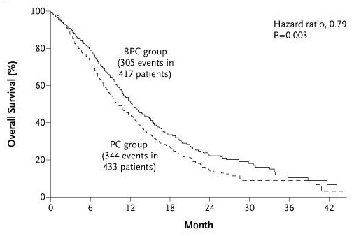
The state of the art initial therapy in 2006…
Addition of a VEGF antibody to chemotherapy improved outcomes a little
Sandler et al, NEJM 2006

Slide 27
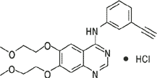
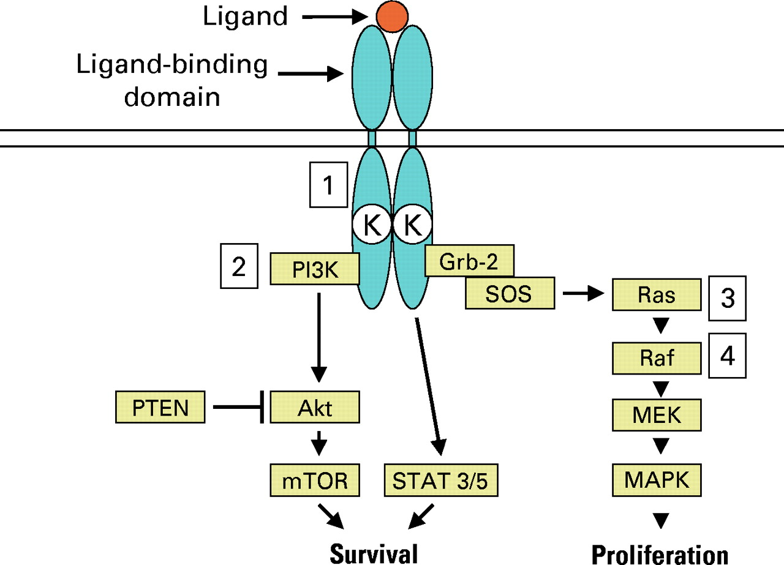
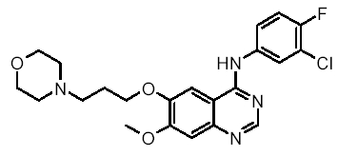
Epidermal Growth Factor Receptor
Signaling
erlotinib
gefitinib
Pao, W. et al. JCO 23:2556-2568 2005

Slide 28
Randomized Trial of Erlotinib
in non-small cell lung cancer
Stage IIIB/IV NSCLC
PS 0–3
1-2 prior therapies
erlotinib + supportive care
placebo + supportive care
Shepherd FA, et al. N Engl J Med. 2005;353:123-132.

Slide 29
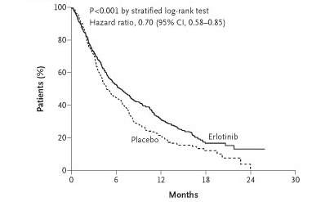
Randomized Trial of Erlotinib in non-small cell lung cancer
Response Rate 9%
Shepherd et al NEJM 353:123-132

Slide 30

Randomized Trial of Erlotinib in non-small cell lung cancer
Response Rate 9%
approved
Shepherd et al NEJM 353:123-132

Slide 31
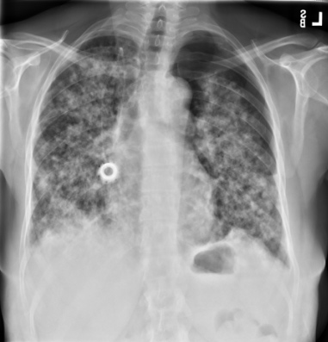
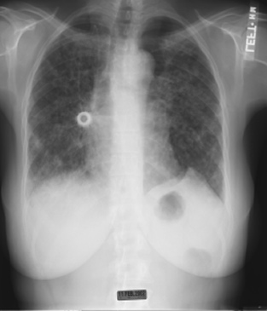
Why Are 1 in 10 Like This?
Day 1
Day 5

Slide 32
Clinical Factors Associated With Response to EGFR TKI
East Asian
Never Smokers
Tumors with adenocarcinoma histology

Slide 33

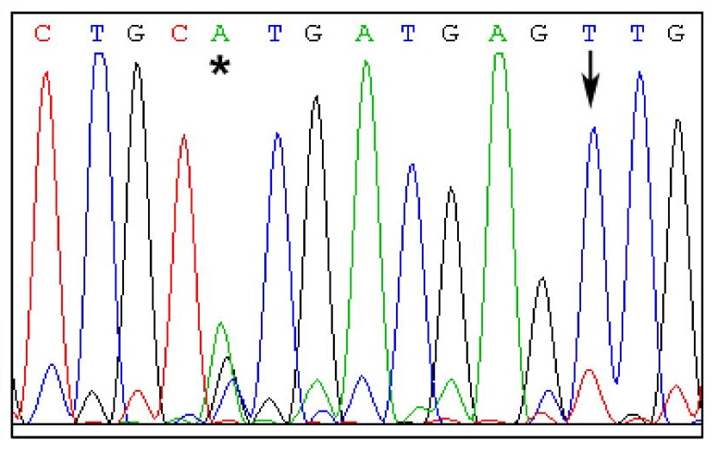
Epidermal Growth Factor Receptor

Slide 34
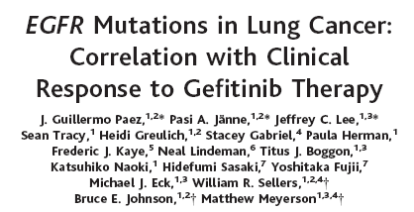
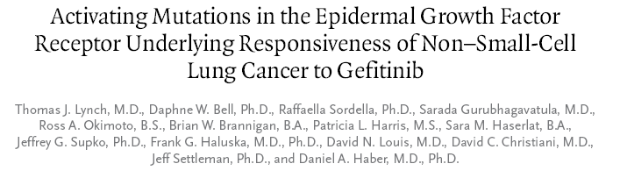
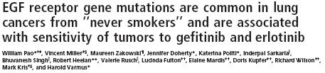
2004
Paez JG, et al. Science. 2004;304(5676):1497-1500.
Lynch TJ, et al. N Engl J Med. 2004;350(21):2129-2139.
Pao W, et al. Proc Natl Acad Sci U S A. 2004;101(36):13306-13311.

Slide 35
EGFR mutations in Non-small cell lung cancer
Exon 19
Deletions
L858R
Clearly associated with response to EGFR TKI
Activating mutations (constitutive activation of EGFR signaling)
Introducing and expressing these mutations in mouse lungs causes lung cancers to develop

Slide 36
EGFR TKI vs Carboplatin - Paclitaxel in Never- or Light Ex-Smokers
Measurable Stage IIIB or IV
Adenocarcinoma histology
No prior chemotherapy
PS 0-2
<100 cigarettes/lifetime or <10 pack- years and stopped ≥15 years prior
R
A
N
D
O
M
I
Z
E
Gefitinib 250 mg/day
Carboplatin AUC 5 or 6
Paclitaxel 200 mg/m²
q3wk (max 6 cycles)

Slide 37
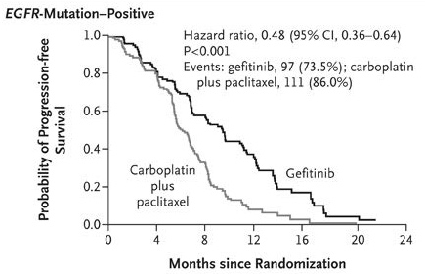
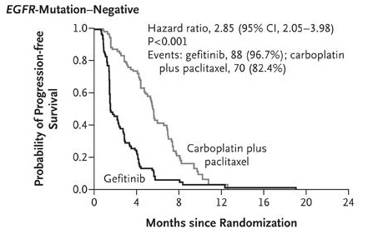
EGFR TKI vs Chemotherapy (Carboplatin-Paclitaxel)
Mok TS, et al. N Engl J Med. 2009;361(10):947-957.
Mok et al NEJM 2009

Slide 38
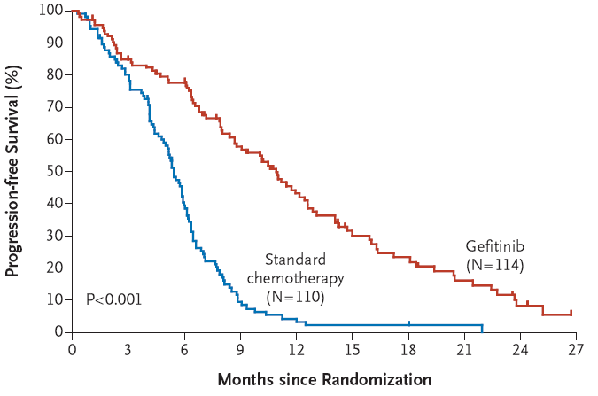
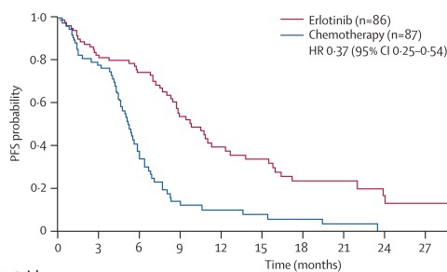
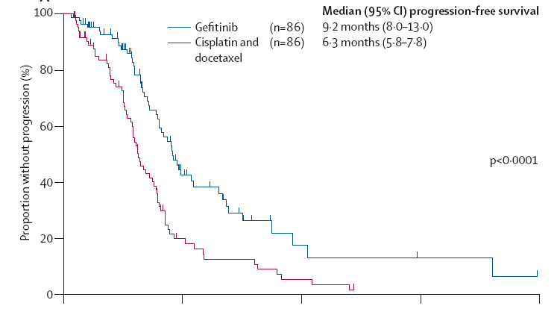
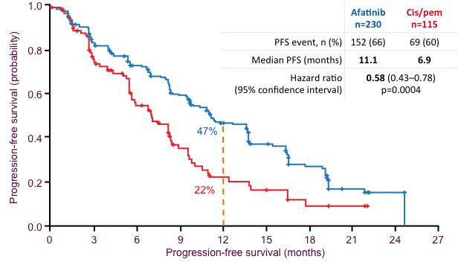
Maemondo et al NEJM 2010, Mitsudomi et al Lancet Oncol 2010, Rosell et al Lancet Oncol 2012, Sequist et al, 2014

Slide 39
EGFR Tyrosine Kinase Inhibitors
(Erlotinib, Gefitinib, or Afatinib)
are better than platinum doublets
in patients with EGFR mutant NSCLC
Maemondo et al NEJM 2010, Mitsudomi et al Lancet Oncol 2010, Rosell et al Lancet Oncol 2012, Sequist et al, 2014

Slide 40
What causes resistance to EGFR TKI?
Diagnosed with EGFR mutant NSCLC
EGFR TKI
Development of Clinical Resistance to EGFR TKI
Biopsy to understand mechanism of resistance

Slide 41
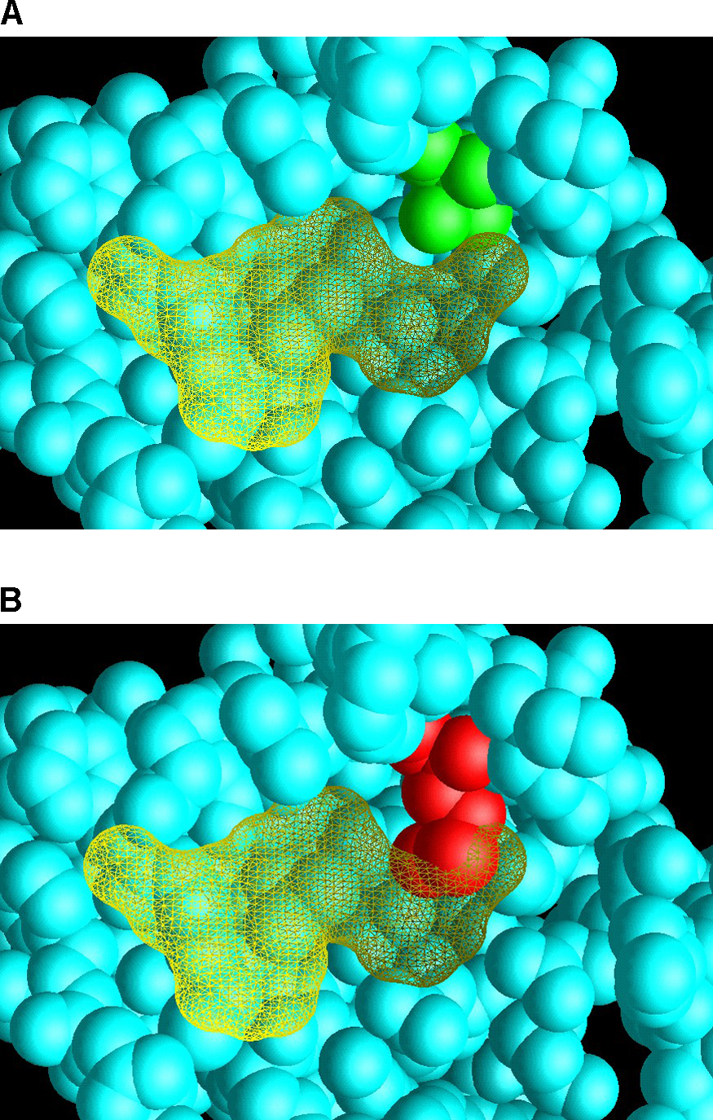
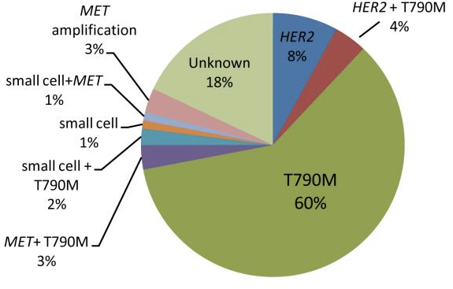
Mechanisms of Acquired Resistance to EGFR Tyrosine Kinase Inhibitors
EGFR T790M is the most common acquired mutation that, in the lab and in patients, causes resistance to EGFR TKI
Clark et al, PLoS Med 2005
Yu et al, CCR 2013

Slide 42
Spectrum of Activity of EGFR TKIs
 | Drug | EGFR
1st gen | gefitinib | +
 | erlotinib | +
2nd gen | afatinib | +

Slide 43
Spectrum of Activity of EGFR TKIs
 | Drug | EGFR | EGFR L858R | EGFR Exon 19 del
1st gen | gefitinib | + | + | +
 | erlotinib | + | + | +
2nd gen | afatinib | + | + | +

Slide 44
Spectrum of Activity of EGFR TKIs
 | Drug | EGFR | EGFR L858R | EGFR Exon 19 del | EGFR T790M*
1st gen | gefitinib | + | + | + | -
 | erlotinib | + | + | + | -
2nd gen | afatinib | + | + | + | -
*Common resistance mechanism to 1st and 2nd generation EGFR TKI

Slide 45
Spectrum of Activity of EGFR TKIs
 | Drug | EGFR | EGFR L858R | EGFR Exon 19 del | EGFR T790M*
1st gen | gefitinib | + | + | + | -
 | erlotinib | + | + | + | -
2nd gen | afatinib | + | + | + | -
3rd gen | osimertinib | - | + | + | +
*Common resistance mechanism to 1st and 2nd generation EGFR TKI

Slide 46
Osimertinib vs Gefitinib or Erlotinib Randomized Trial
Osimertinib
(n=279)
Metastatic NSCLC
EGFR mutation
No prior therapy
Stable CNS metastases allowed
Performance status 0 / 1
Gefitinib or Erlotinib
(n=277)
Primary endpoint: PFS
Secondary endpoints: response rate, duration of response, disease control rate, depth of response, overall survival, patient reported outcomes, safety
Soria et al, NEJM 2017

Slide 47
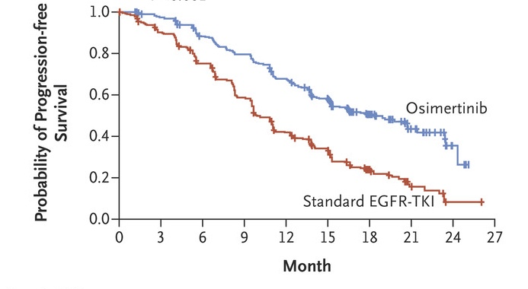
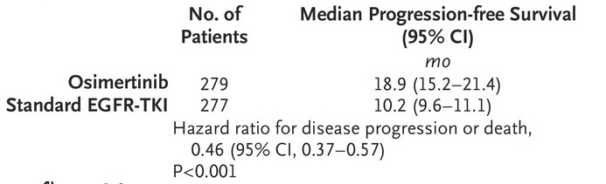
Osimertinib vs Gefitinib or Erlotinib as first-line treatment for NSCLC - Progression-Free Survival
Soria et al, NEJM 2017

Slide 48
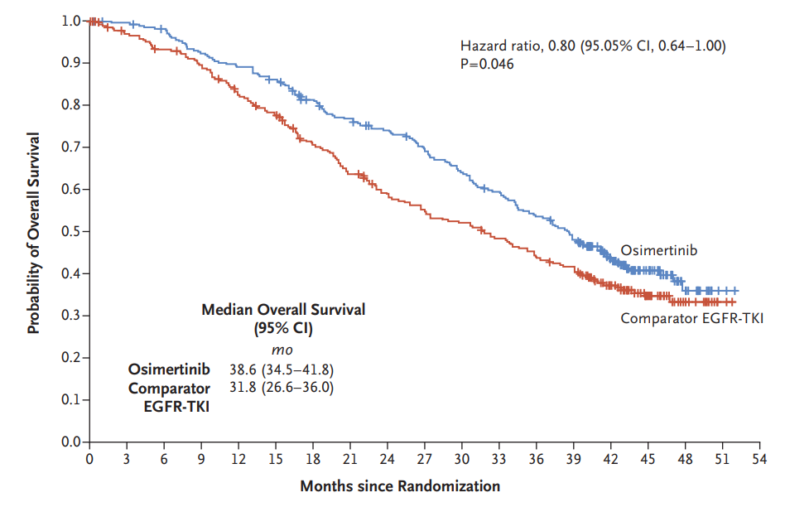
Osimertinib vs Gefitinib or Erlotinib as first-line treatment for NSCLC - Overall Survival
Ramalingam et al, NEJM 2020

Slide 49

Osimertinib vs Gefitinib or Erlotinib as first-line treatment for NSCLC - Overall Survival
Ramalingam et al, NEJM 2020

Slide 50
The triumph of precision medicine in solid tumors…
There was a molecularly-defined drug target
Patients were treated with a first-generation targeted therapy which had modest efficacy (erlotinib, gefitinib, afatinib)

Slide 51
The triumph of precision medicine in solid tumors…
There was a molecularly-defined drug target
Patients were treated with a first-generation targeted therapy which had modest efficacy (erlotinib, gefitinib, afatinib)
Translational work identified how patients develop acquired resistant (dominant mechanisms was emergence of T790M)

Slide 52
The triumph of precision medicine in solid tumors…
There was a molecularly-defined drug target
Patients were treated with a first-generation targeted therapy which had modest efficacy (erlotinib, gefitinib, afatinib)
Translational work identified how patients develop acquired resistant (dominant mechanisms was emergence of T790M)
A drug was developed to target the mechanism of resistance (3rd generation EGFR TKI like osimertinib) and it improved initial therapy outcomes

Slide 53
The triumph of precision medicine in solid tumors…
There was a molecularly-defined drug target
Patients were treated with a first-generation targeted therapy which had modest efficacy (erlotinib, gefitinib, afatinib)
Translational work identified how patients develop acquired resistant (dominant mechanisms was emergence of T790M)
A drug was developed to target the mechanism of resistance (3rd generation EGFR TKI like osimertinib) and it improved initial therapy outcomes
Target
Resistance
Now, all we need to do is iterate, right?

Slide 54
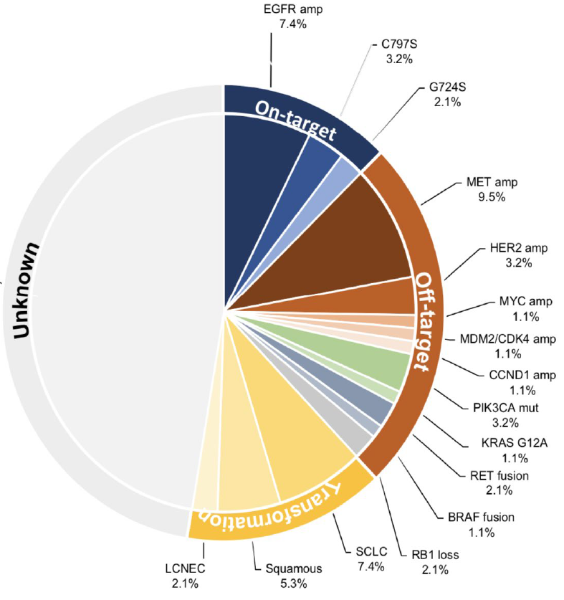
Mechanisms of acquired resistance to 3rd generation EGFR TKI are much more complicated!
Choudhury et al, J Thor Onc, 2023

Slide 55
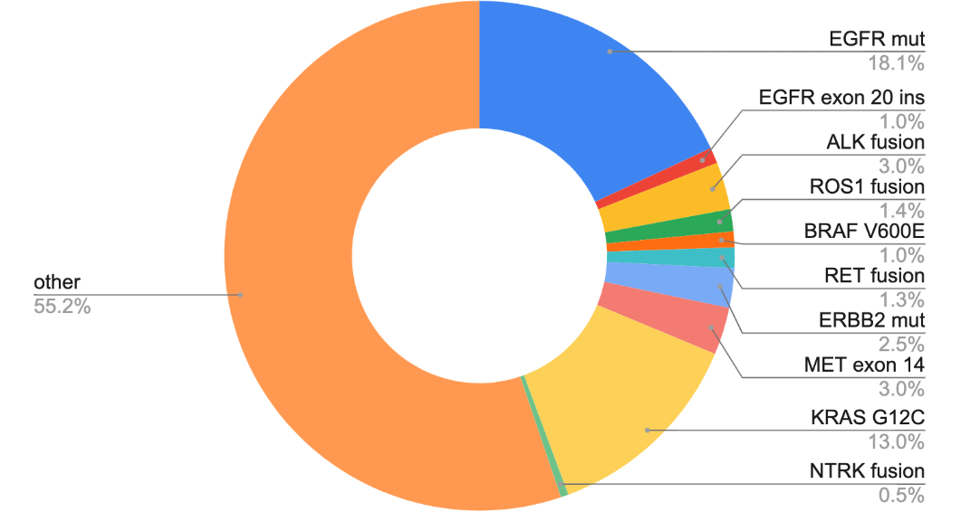
Lung cancer molecular subtypes with FDA-approved agents
FDA-approved 1st line therapies
Erlotinib, gefitinib, afatinib, dacomitinib, osimertinib, amivantamab, lazertinib
amivantamab
Crizotinib, alectinib, brigatinib, ceritinib, lorlatinib, ensartinib
Crizotinib, entrectinib, repotrectinib
Encorafenib/binimetinib, dabrafenib/trametinib
Pralsetinib, selpercatinib
Tepotinib, capmatinib
Entrectinib, Larotrectinib
AACR GENIE BPC lung, Data available at https://genie.cbioportal.org/

Slide 56
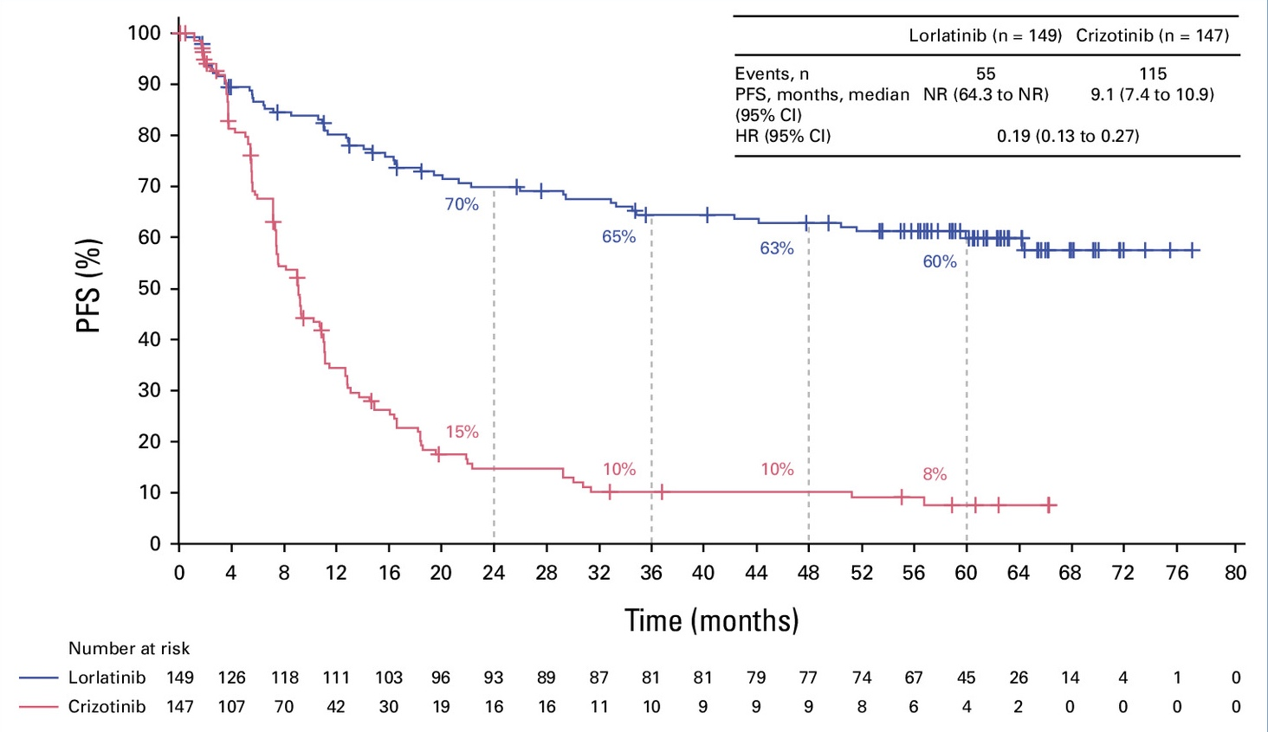
Targeted therapy can lead to long-term responses lorlatinib in ALK positive lung cancer
Solomon et al, JCO 2024

Slide 57
So, today, when we meet a new patient with non-small cell lung cancer…
Initial biomarker characterization is key. How do we do it?
Adequate testing covers all 9 of the genes noted
Typical commercial platform covers hundreds of genes and we get results in <2 weeks
If adequate tissue wasn’t collected we can sometimes get this information by looking for shed tumor DNA in plasma (ctDNA, “liquid biopsy”)
In addition to molecular testing, we also test for other markers (e.g. PD-L1 levels) to determine the role of immunotherapy/chemotherapy

Slide 58
The Current Approach to First-Line Treatment of Patients with Advanced NSCLC
Stage IV NSCLC
Histologic Assessment
+
Molecular Analysis
+
PD-L1 Testing
PD-L1 <50%
~30%
of patients
Mutations/
rearrangement
~40%
of patients
PD-L1 ≥50%
~30%
of patients

Slide 59
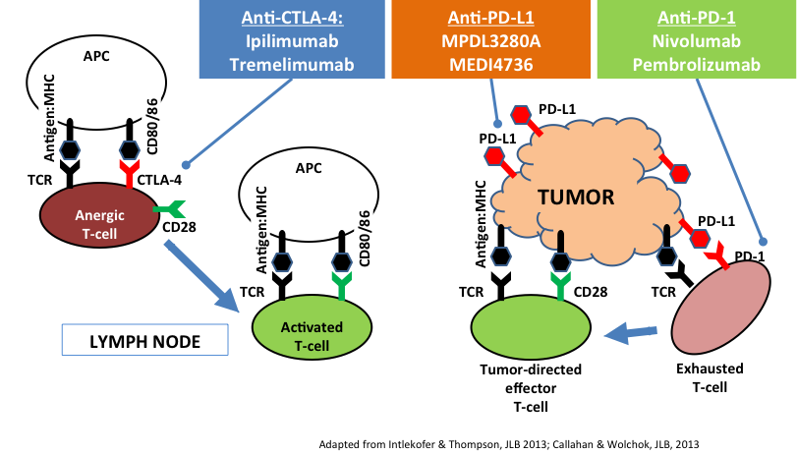
Basics of Immunotherapy
Anti-PD-L1
Atezolizumab
Durvalumab

Slide 60
Cast of Characters
PD-1/PD-L1 antibodies
nivolumab
pembrolizumab
atezolizumab
durvalumab
cemiplimab
avelumab

Slide 61
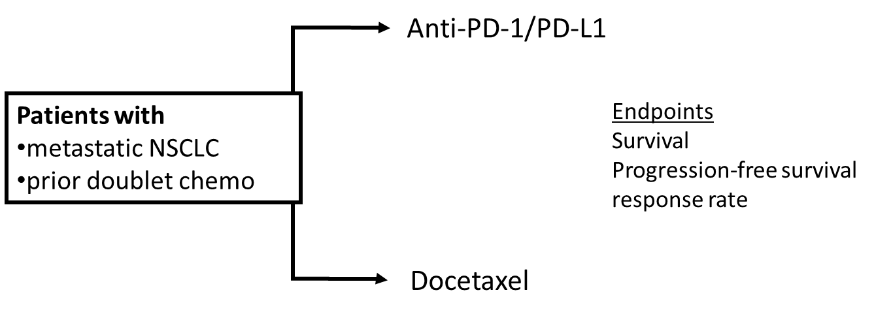
Generic Trial Design to Evaluate 2nd line Checkpoint Inhibitors

Slide 62
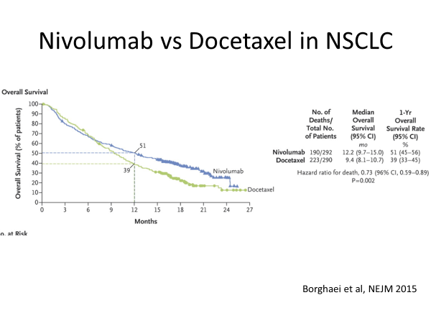

Slide 63
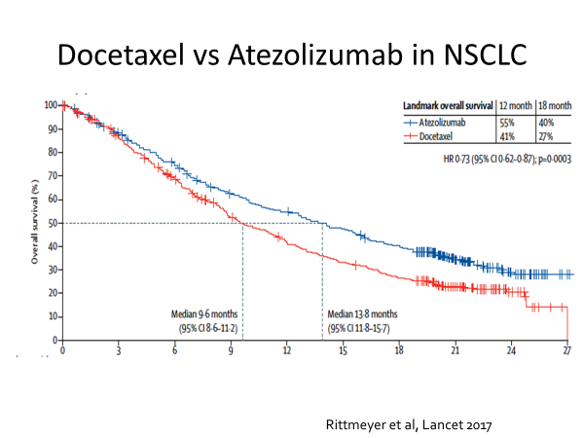

Slide 64
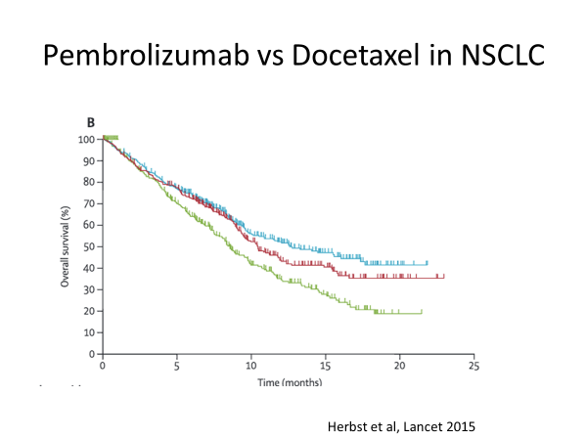
Single-agent anti-PD-1/PD-L1 is better than a lousy chemotherapy

Slide 65
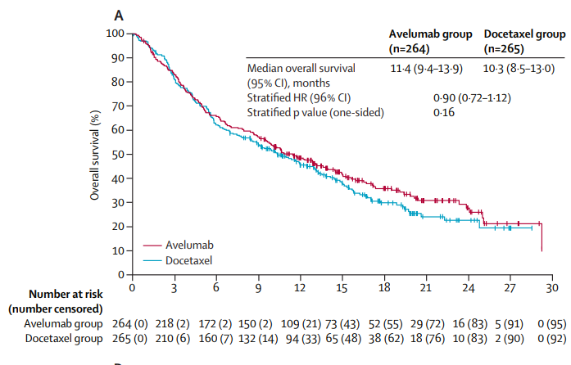
But, it doesn’t always work
Barlesi et al, Lancet Onc 2018

Slide 66
Even when it improves outcomes, can we do better?
The curves are different, but not dramatic. Can we figure out who is getting the most benefit?

Slide 67
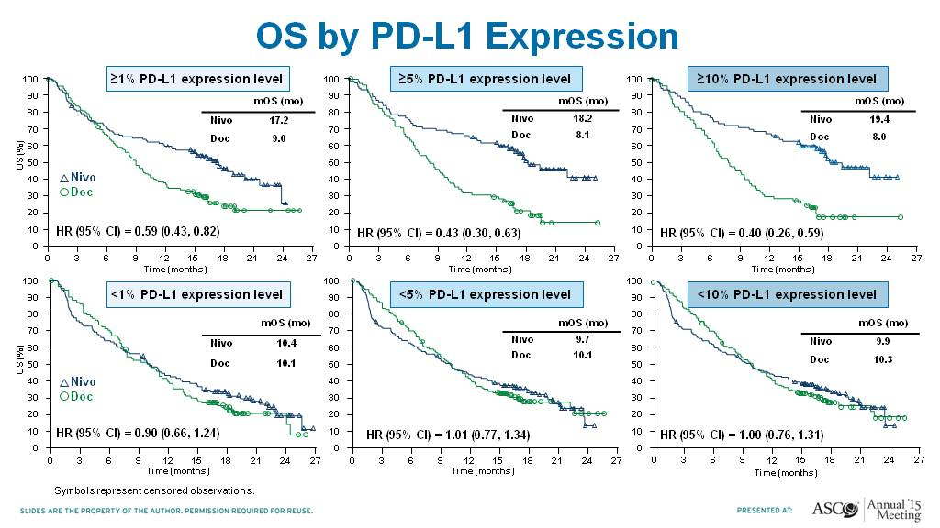
OS by PD-L1 Expression
Nivolumab in Non-Squamous Cell Lung Cancer
Paz-Ares et al ASCO 2015

Slide 68
Summary of Immunotherapy after Initial Therapy
As single-agents, atezolizumab, pembrolizumab, and nivolumab were all proven superior to docetaxel for the treatment of patients with NSCLC previously treated with platinum-based therapy (aka “second line”)
PD-L1 is a biomarker (it has limitations and challenges)
Small note: Use of pembrolizumab in “second line” requires evidence of PD-L1 expression

Slide 69

Sometimes, we aren’t so creative
We know treatment A (platinum doublet) works
We know treatment B (anti-PD-1/PD-L1 antibody) works after drug A
We should combine A + B!

Slide 70
Randomized Trial of Chemotherapy +/- Pembrolizumab in “non-squamous” NSCLC (Keynote 189)
Recurrent/metastatic nonsquamous NSCLC
no prior chemo
no EGFR+ or ALK+
sample for PD-L1 IHC status
no symptomatic brain metastases
No pneumonitis
pembrolizumab + carboplatin/cisplatin + pemetrexed
4 cycles
pembrolizumab + pemetrexed
R 2:1
carboplatin/cisplatin + pemetrexed
4 cycles
placebo + pemetrexed
Gandhi et al NEJM 2018

Slide 71
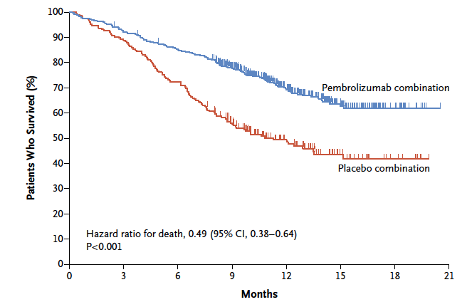
Randomized Trial of Chemotherapy +/- Pembrolizumab in “non-squamous” NSCLC - OS
Gandhi et al NEJM 2018

Slide 72
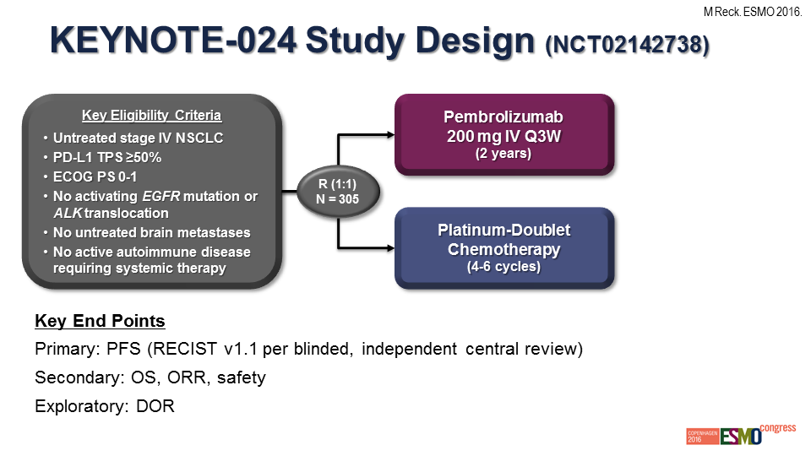
Pembrolizumab (anti-PD-1 Antibody) vs Chemotherapy
in Patients whose tumors are PD-L1 ≥ 50%
Reck et al, ESMO 2016

Slide 73
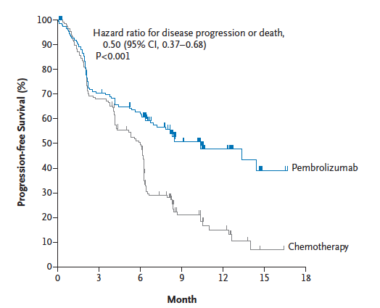
Pembrolizumab vs Chemotherapy in Patients whose tumors are PD-L1 ≥ 50%
Reck et al, NEJM 2016

Slide 74
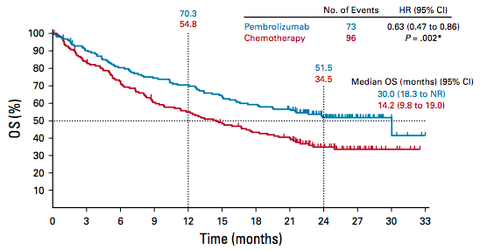
Pembrolizumab vs Chemotherapy in Patients whose tumors are PD-L1 ≥ 50% Overall Survival
Reck et al, JCO 2019

Slide 75
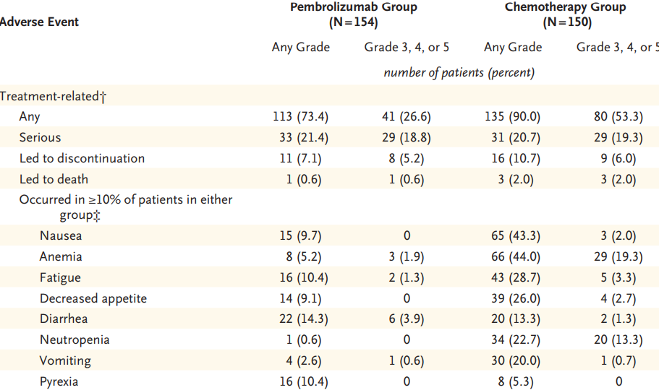
Pembrolizumab is Associated with Fewer Adverse Events than Chemotherapy
Reck et al, NEJM 2016

Slide 76
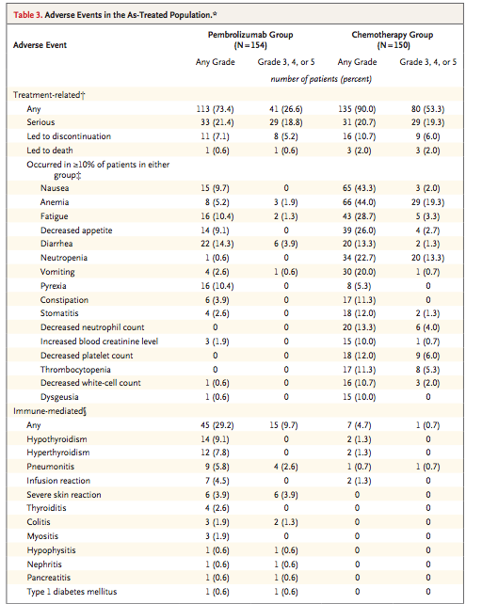
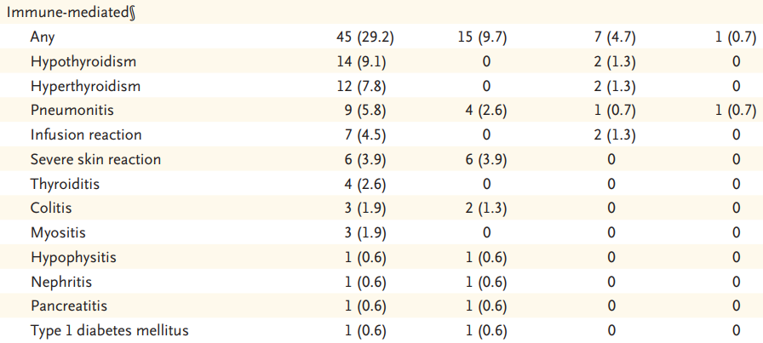
There are Immune-Related Adverse Events
Reck et al, NEJM 2016

Slide 77
Open question…
For patients with PD-L1 ≥ 50% which is better?
single-agent checkpoint inhibitor
or
chemotherapy + [ICI]?
No trial data
Symptoms? PD-L1 level (90% vs 50%)?

Slide 78
What about some of the more challenging targets?
Mutations/Gene Fusions (by NGS)
KRAS…more than a quarter of NSCLC!
Notes:
NCCN Clin Info MH 3/28/23: Title: Is this is metastatic NSCLC? Is it adenocarcinoma?

Slide 79
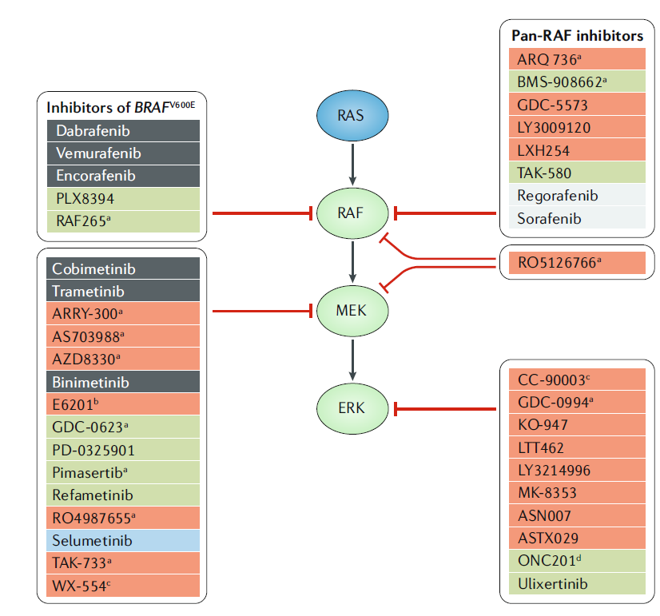
How do we target KRAS mutant cancers?
Prior to development of direct KRAS inhibitors, the focus was on inhibition of downstream signaling molecules.
Ryan and Corcoran, Nat Reviews Clinical Oncology 2018

Slide 80
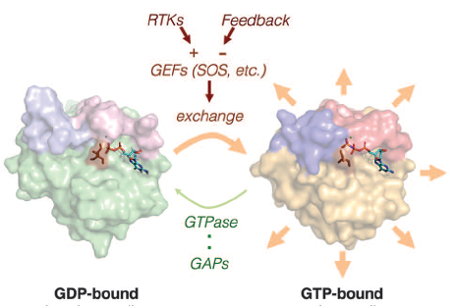
Mutations in RAS lack GTPase activity, leaving mutant KRAS constitutively active
Fixing an enzyme that is broken is hard
Modified from Lito et al, Science 2016

Slide 81
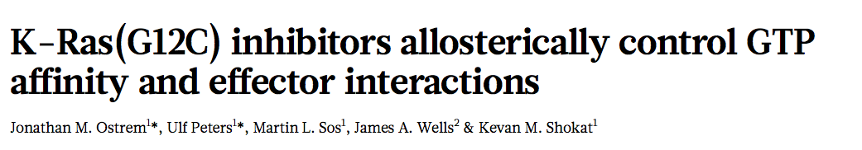
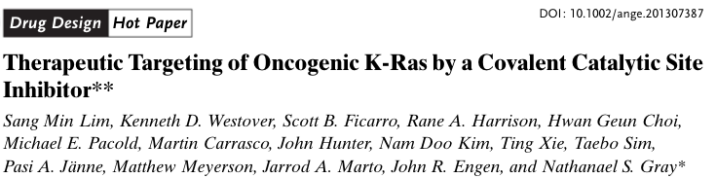
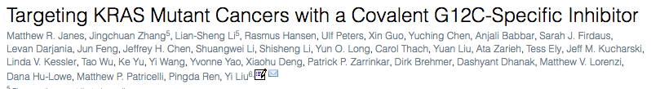
The New Hope – Direct RAS inhibitors
Nature 2013
Angewandte Chemie International Edition 2013
Cell 2018

Slide 82
Mutations in RAS lack GTPase activity, leaving mutant KRAS constitutively active
Fixing an enzyme that is broken is hard
Modified from Lito et al, Science 2016

Slide 83

It turns out that mutant KRAS does have low level GTPase activity
Lito et al, Science 2016

Slide 84

KRAS G12C inhibitors bind inactive, GDP-bound RAS G12C and trap it in an inactive state
Lito et al, Science 2016

Slide 85




Skoulidis F, Li B et al, NEJM 2021

Slide 86




Jänne PA, Riely GJ et al. NEJM 2022;387(2):120-31.

Slide 87


Randomized Trials targeting KRAS G12C
KRAS targeted therapy
KRAS mutant NSCLC
Previously treated with chemo/IO
docetaxel
Sotorasib
Adagrasib
Langen et al Lancet 2023
Mok et al ASCO 2024

Slide 88


Resistance to KRAS G12C inhibitors develops from multiple mechanisms
Zhao et al, Nature 2021

Slide 89
Conclusions
Developing targeted therapies can make significant improvements in outcomes for patients with NSCLC
Testing for genomic alterations is critical to knowing
This requires adequate tissue to be obtained at time of diagnosis
Identifying mechanisms of resistance is important and can sometimes lead to the next therapy
True progress requires translational science and randomized clinical trials

Slide 90
Acknowledgements
Thoracic Oncology Service
Mark Kris
Charlie Rudin
Paul Paik
Jamie Chaft
Noura Choudhury
Marjorie Zauderer
Helena Yu
Alex Drilon
Kathryn C. Arbour
Robert Daly
Adam Schoenfeld
Mark Awad
Pathology
Marc Ladanyi
Maria Arcila
William Travis
Natasha Rehktman
Andre Moreira
Sloan Kettering Institute
Neal Rosen
Piro Lito
Scott Lowe
Dana Farber Cancer Institute
Päsi Janne
Cloud Paweletz
Funding Sources
Stand Up 2 Cancer
National Cancer Institute
Mark Foundation
Ning Zhao and Ge Li Initiative for Lung Cancer Research
Dallepezze Family Foundation
Mirati
Takeda
AACR

